Slide 1
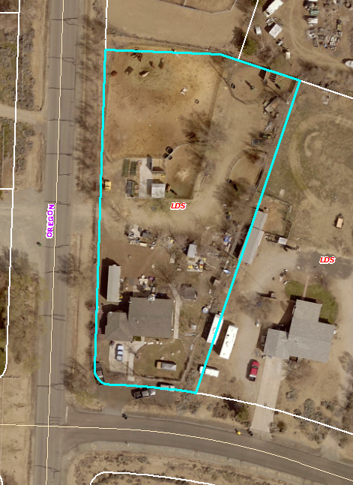
WVIO-BUI17-0106, George Pizarro
Washoe County Board of Adjustment
May 2, 2019

Slide 2
Overview
The applicant has moved two structures to the subject site, each of which is greater than 200 square feet in size.
A “shed”
A “construction trailer”
Building permits have not been obtained for either of the two structures.

Slide 3
Overview
Washoe County Code Section 100.105.1, requires that, “Any owner or authorized agent who intends to construct, enlarge, alter, repair, move, demolish, or change the occupancy of a building or structure, or to erect, install, enlarge, alter, repair, remove, convert or replace any electrical, gas, mechanical or plumbing system, the installation of which is regulated by this code, or to cause any such work to be done, shall first make application to the building official and obtain the required permit.”

Slide 4
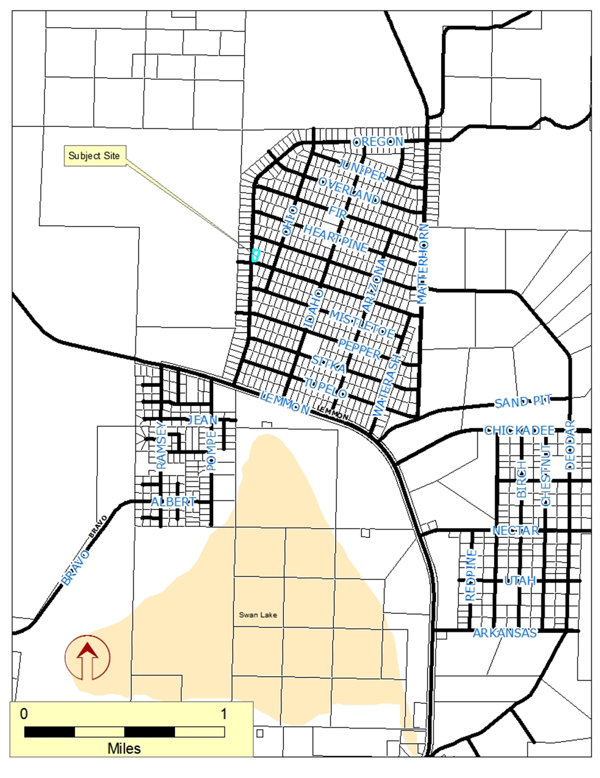
Vicinity Map

Slide 5
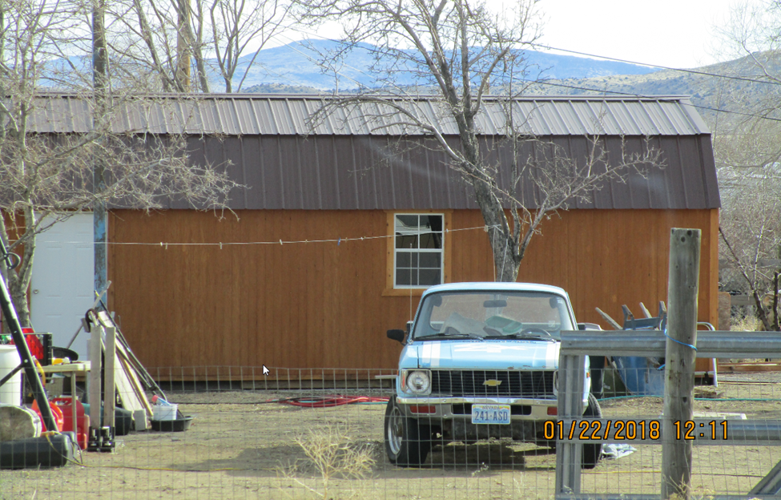
“Shed”

Slide 6
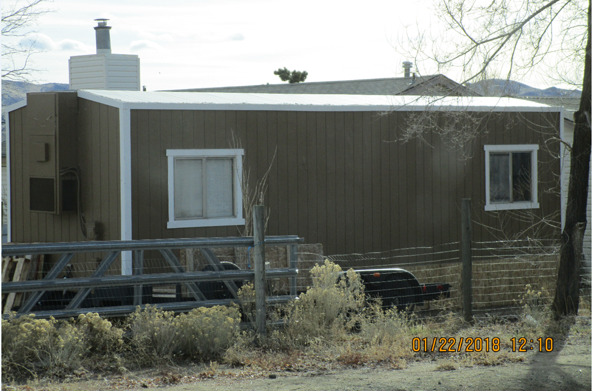
“Construction Trailer”

Slide 7
Evaluation
Please see Exhibit A for a more comprehensive list of the interactions between Washoe County Staff and the appellant.
11/28/17 Anonymous complaint, mobile home added to property, additional shed that exceeds 200sq. ft.
1/22/18 Administrative Warning letter sent.
January – June 2018 several meetings and communication with various Washoe County Staff
7/11/18 1st Penalty Notice
8/16/2018 2nd Administrative Warning sent
8/31/18 Administrative Warning refused and returned

Slide 8
Evaluation
9/26/2018 Penalty Posted on the property
10/31/18 3rd Administrative Warning Sent
11/19/18 Outstanding fees from the 1st and 2nd penalties sent to Collections
12/11/18 3rd Penalty sent (regular mail and certified)
12/24/18 Certified copy of 3rd Penalty returned as "refused.“
12/26/18 3rd penalty had been appealed
2/5/19 Administrative Hearing Held

Slide 9
Evaluation
2/5/2019 Administrative Hearing Officer affirmed that, “I find the cited violations are supported by the evidence.” The Administrative Order requires that, “By April 20, 2019: 1) permit or remove shed 2) remove construction trailer or hearing to determine compliance may be requested”
2/19/19 Decision of Administrative Hearing Officer appealed to the Board of Adjustment

Slide 10
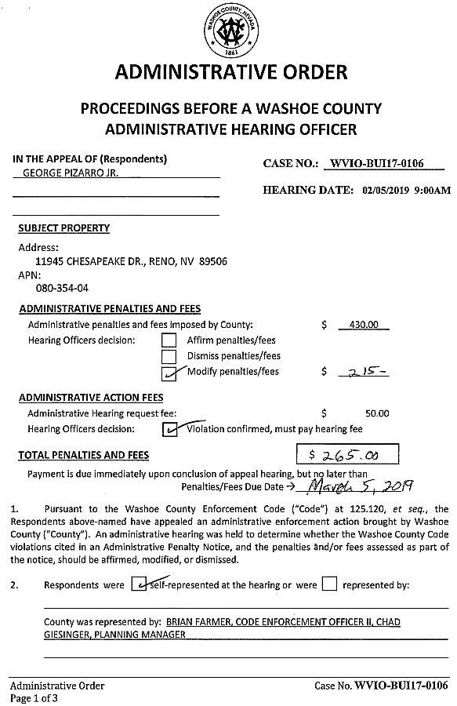
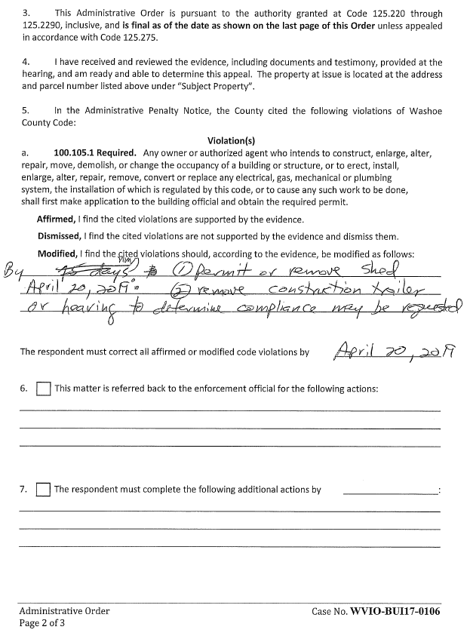
Administrative Hearing Officer Decision

Slide 11
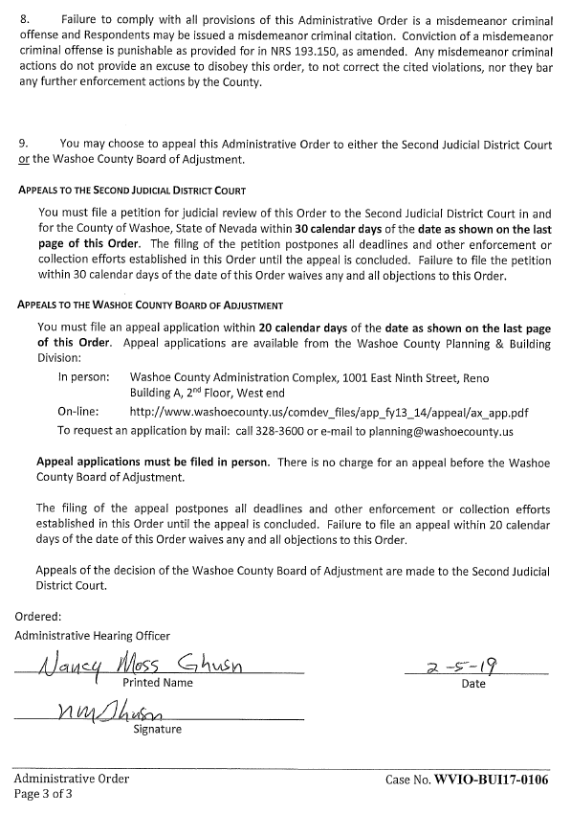
Administrative Hearing Officer Decision

Slide 12
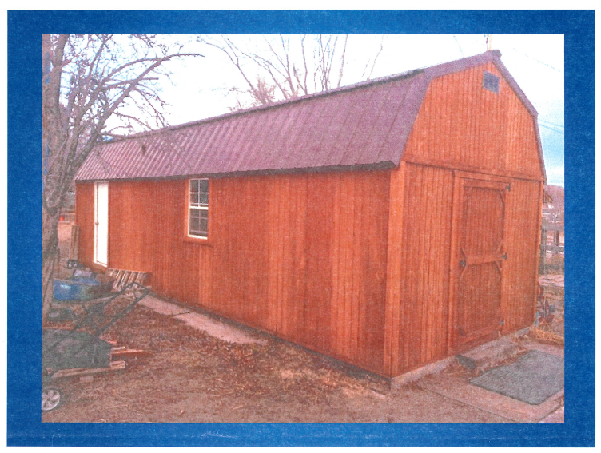
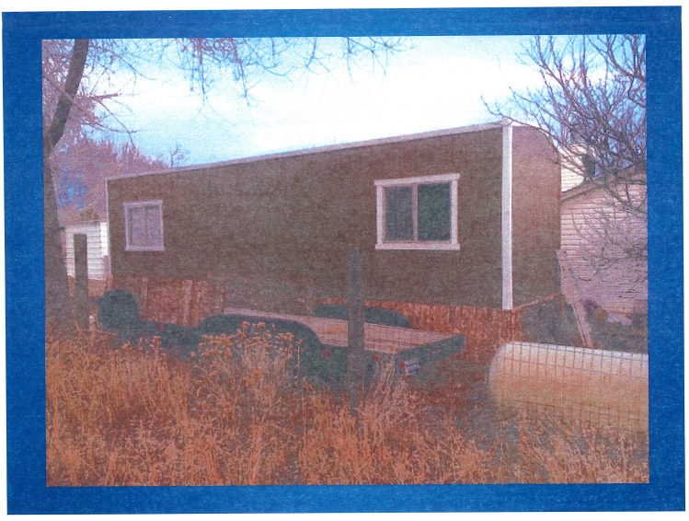
Evaluation
There is no dispute that the “shed” and “construction trailer” are currently located on the subject site.
The appellant provided the following photos (Exhibit E to your Staff Report) to the Administrative Hearing Officer during the hearing on February 5, 2019:

Slide 13
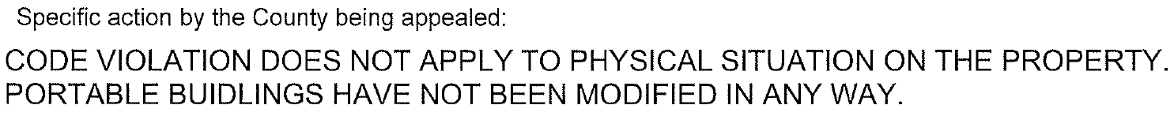
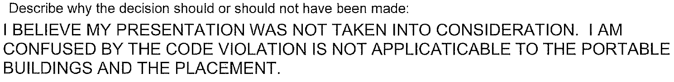
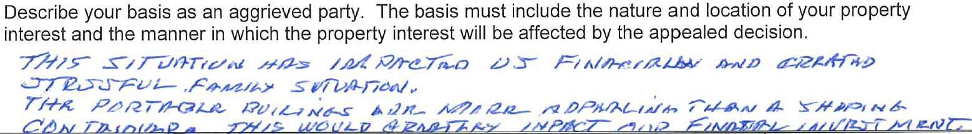
Basis for Appeal (Exhibit C to Staff Report)

Slide 14
Recommendation (Staff Report Page 8)
Based upon staff analysis, evidence presented, and testimony received, staff recommends that the Board of Adjustment deny this appeal and affirm the decision of the Administrative Hearing Officer, that the appellant is in violation of Washoe County Code Section 100.105.1.

Slide 15
Possible Motion (Staff Report Page 8)
I move that, after giving reasoned consideration to the information contained in the staff report and information received during the public hearing, the Washoe County Board of Adjustment affirm the decision of the Administrative Hearing Officer that the appellant has “move[d]…a building or structure…” greater than 200 square feet in size to the subject site and has violated WCC Section 100.105.1; and, authorize the Chair of the Board of Adjustment to prepare a written order of the decision and file it with the Secretary of the Board of Adjustment, a copy of which shall be served to the appellant.

